Slide 1

Enhancing Compiler Robustness through Predictive Parsing: A Novel Approach to Error Detection and Recovery

Slide 2
The Importance of Error Handling in Compilers
Accuracy and Efficiency
Software Quality and Reliability
Error detection and recovery mechanisms are essential for ensuring the accuracy and efficiency of the compilation process. By promptly identifying and addressing errors, compilers can reduce development time and minimize potential issues.
Robust error handling improves the overall quality and reliability of the software. Developers gain confidence in the generated code, leading to more stable and secure applications.

Slide 3
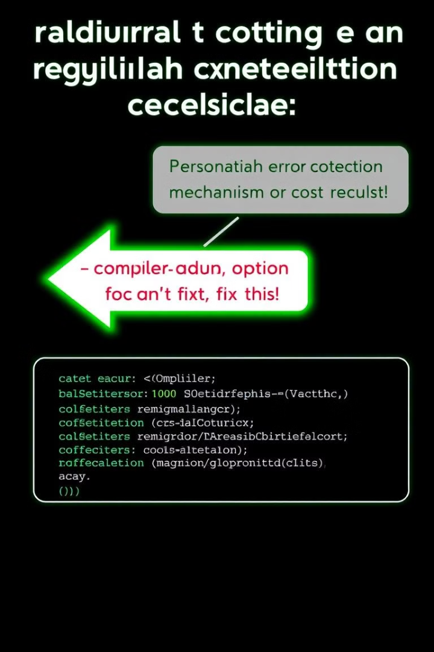
Limitations of Traditional Error Detection and Recovery Methods
Cumbersome and Error-Prone
Limited Scalability
These methods struggle to adapt to evolving language standards and software requirements, hindering their ability to handle diverse code structures and error scenarios.
Traditional methods involving manual coding or regular expressions can be complex and prone to errors, particularly when dealing with intricate language structures.

Slide 4
The Rise of Predictive Parsing for Compiler Error Handling
Enhanced Accuracy and Flexibility
Improved Efficiency
Predictive parsing leverages grammar rules to anticipate code structure and identify errors with higher precision, offering greater flexibility in handling diverse code patterns.
By anticipating errors, predictive parsing enables compilers to identify issues early in the compilation process, streamlining the debugging phase and accelerating development cycles.

Slide 5

Leveraging Machine Learning for Advanced Error Detection and Recovery
1
1. Automated Learning and Adaptation
2
2. Dynamic Error-Recovery Rule Generation
Machine learning algorithms can be trained on historical data and user feedback, enabling compilers to automatically learn and adapt error-handling strategies.
Reinforcement learning techniques allow compilers to adapt to evolving code patterns and dynamically generate error-recovery rules, further improving the robustness of error management.

Slide 6
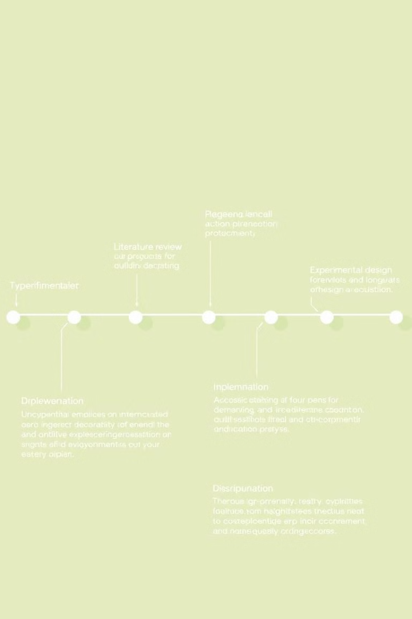
Research Plan: A Step-by-Step Approach to Evaluating Predictive Parsing for Compiler Error Handling
1
Phase 1: Literature Review
An in-depth exploration of existing literature on error detection, recovery techniques, and predictive parsing in compiler design will lay the foundation for the research project.
2
Phase 2: Experimental Design and Implementation
The development and testing of a prototype compiler system incorporating predictive parsing algorithms will allow for rigorous evaluation of the technique.
3
Phase 3: Data Analysis and Interpretation
Analysis of experimental data will reveal the effectiveness of predictive parsing in error detection and recovery, leading to insights and recommendations for future research and applications.

Slide 7
Methodology: A Comprehensive Approach to Evaluating Compiler Performance
Data Collection and Preprocessing
Implementation and Evaluation
A diverse dataset of source code examples, encompassing a variety of syntax errors and edge cases, will be compiled and analyzed to ensure the robustness of the compiler's error-handling capabilities.
The predictive parsing algorithm will be implemented and tested against the dataset, with metrics such as accuracy, recovery success rate, and processing speed being carefully measured and analyzed.

Slide 8



Expected Outcomes and Future Directions
1
Improved Software Quality and Reliability
2
Enhanced Developer Productivity and Efficiency
3
Increased User Confidence and Satisfaction

Slide 9




Conclusion: Advancing Compiler Design for a More Robust Software Development Ecosystem
Enhanced Error Detection and Recovery
Improved Software Quality
By automating error identification and recovery, the system helps developers produce high-quality, error-free code, fostering a more efficient and reliable software development ecosystem.
The proposed approach leverages predictive parsing to improve error detection accuracy, efficiency, and usability, leading to more robust and reliable compilers.
Future Research Directions
Further research exploring the integration of machine learning techniques to enhance the adaptability and scalability of error recovery mechanisms holds significant potential for future advancements in compiler design and error management.

